Slide 1
Clustering – Group 1
Developed a customer segmentation to define marketing strategy from credit card data
WHAT
WHY
HOW
Given the dataset This Project aims to develop a customer segmentation to define marketing strategy. The sample Dataset summarizes the usage behavior of about 9000 active credit card holders
Customer Segmentation is a classical problem , using clustering we will be able to make classify customers and see the optimal types of customers based on credit card information like purchases and credit history. This can help the marketing team to make informed decisions on their target audience.
Using Multiple Clustering Techniques including K-means, obtaining optimum no of clusters using elbow and Silhouette and identifying Users Groups from clusters

Slide 2
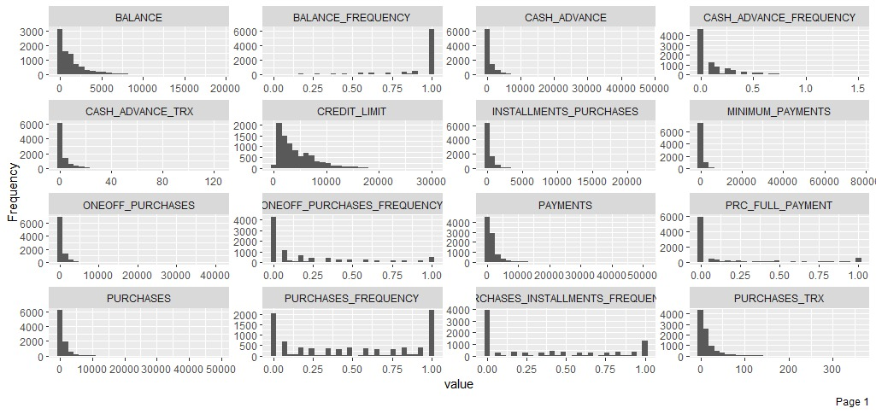
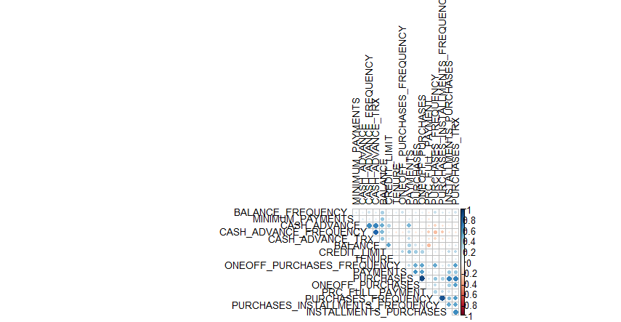
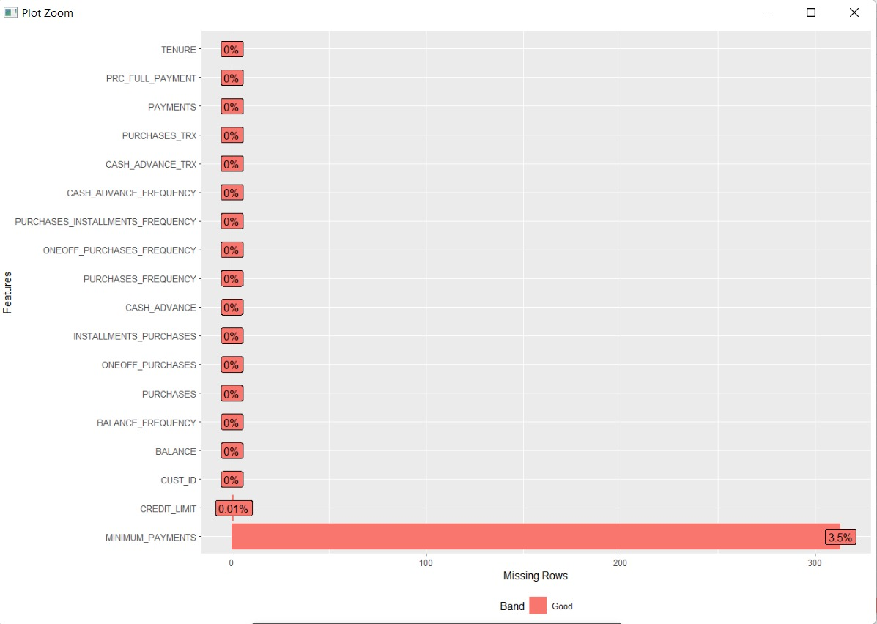
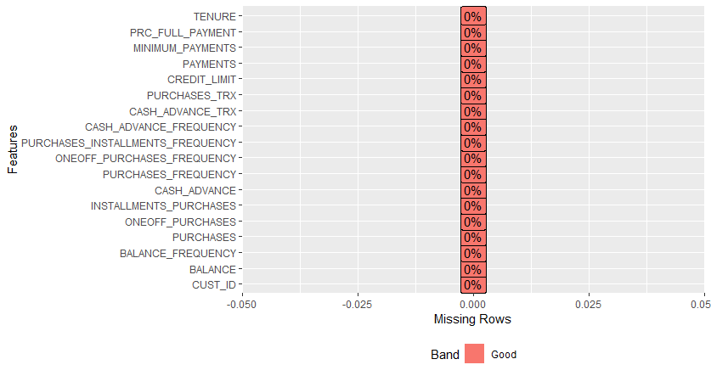
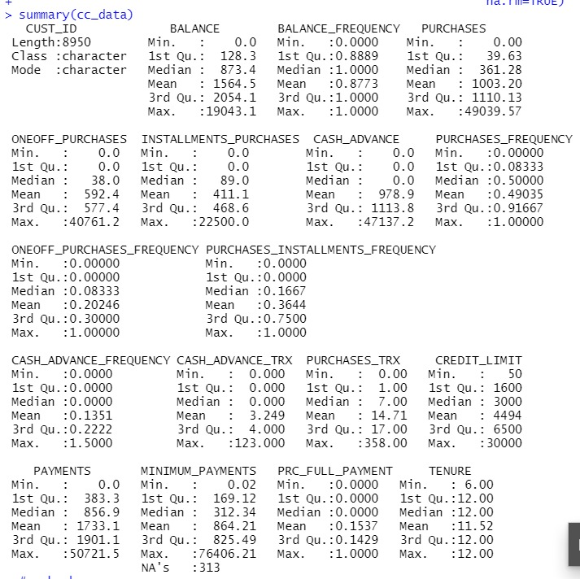
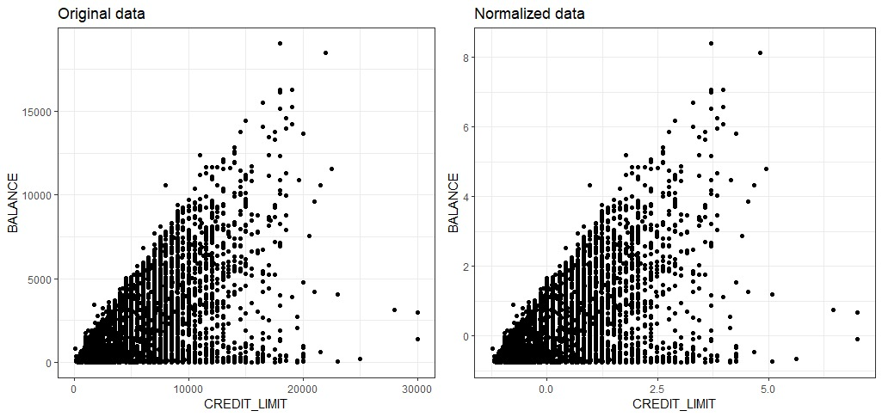
Data Description
Data Summary
Data Cleaning
Exploratory Data Analysis
Feature Scaling
All variables are numeric other than CUST_ID which will be removed for clustering.

Slide 3
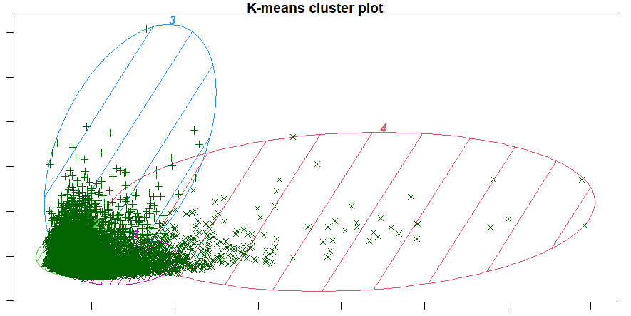
K-MEANS Clustering
K-Means Clustering is an Unsupervised Learning algorithm, which groups the unlabeled dataset into different clusters
We can start four centers for our model, and let's look at the results:

Slide 4
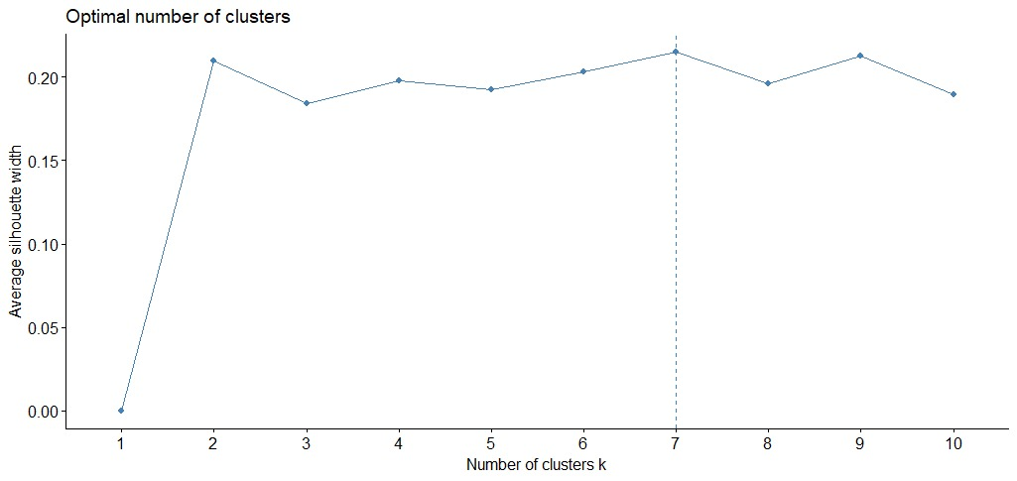
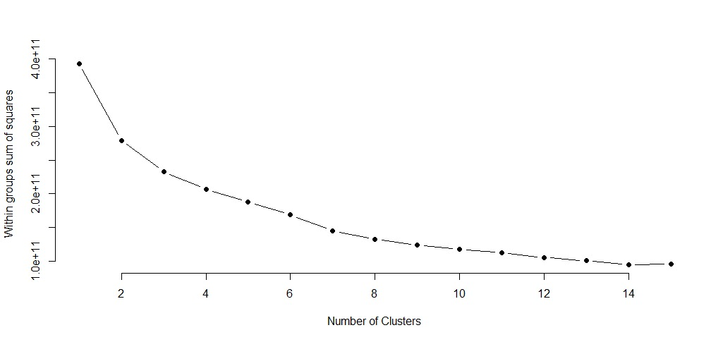
Determining Optimal Number Of Clusters
Elbow Method :
Silhouette Method :
Conclusion: It is evident that 7 clusters are optimal for our model

Slide 5
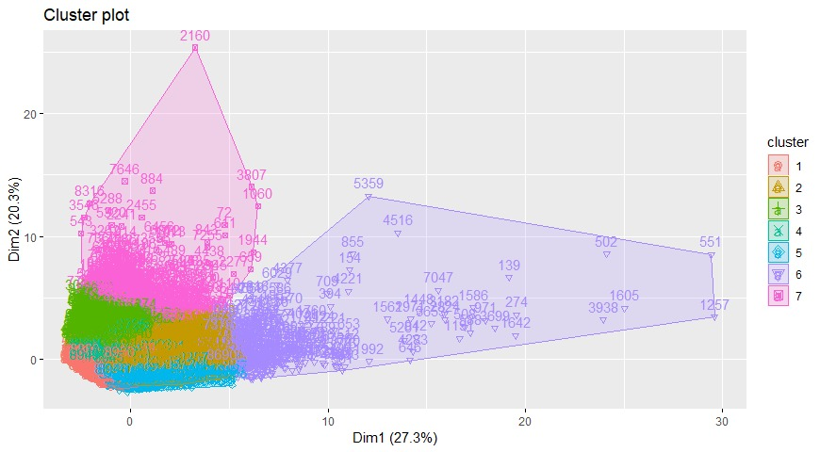
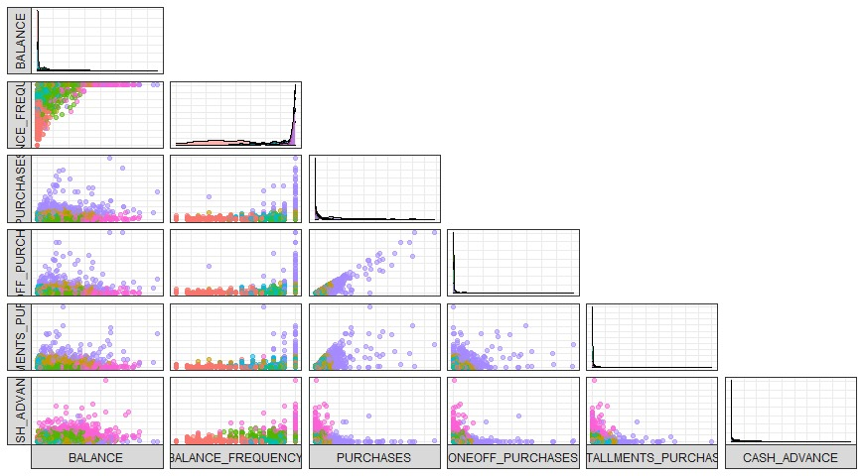
Results
Final Clusters
Features classification by Clusters

Slide 6
Conclusions
1- Subclass user group (RED)
2- Balanced middle-class user group (YELLOW)
3- User group with the smallest expenditures (GREEN)
4- Small Spending and User Group with the Lowest Credit Limit (CYAN)
5- Credit card lovers group (BLUE)
6- User group with big expenditures (PURPLE)
7- user group with high amount of money (PINK)

